Slide 1


Basic Test Execution and Defect Tracking
对美外包软件测试实践课程
Li, Pan
2012/06/20

Slide 2
Outline
1
Test Execution
a
The Definition of Test Execution
b
How to Do Test Execution
2
Defect Tracking - Bugzilla
a
How to Report a New Bug
b
Know Bug Life Cycle

Slide 3
Test Execution
What
Why
Who
Where
When

Slide 4
What is test execution
“The processing of a test case suite by the software under test, producing an outcome”
-BS 7925-1.British Computer Society Specialist Interest Group in Software Testing (BCS SIGIST)
Notes:
Test execution is a process including plan, do, check and action
Target: software under test
Input: a test case suite
Output: outcome

Slide 5
Why needs test execution
Requirement Capture
Test Plan & Design
Test Case Development
Test Execution
Test Results and Reporting
Test Process Analysis
……
Notes:
1. Of course yes, if we did not execute the test, how do we know if the software is behaving as we expert?
2. Execution is a stage in the testing process
3. A proper execution of the suite, is every bit as important as having good test cases. Even in ad-hoc testing, there has to be an awareness of execution procedures.

Slide 6

Who executes the tests

Slide 7
Where are the tests executed
Everywhere that testing takes place is a de facto location to execute testing.
In certain cases execution itself may be complex. The SUT (software under test) has to be tested in multiple environment. For example, Java should be tested in Windows, Mac, and Linux.
Test Execution may be outsourced to a testing lab or other company.
Test environment should be separated with development environment

Slide 8
Test Environment
Analysis environment of production
Elements in test environment
Hardware
Software
Data
Notes:
Analysis environment of production
Ideally, test environment should have been exactly the same as production one. Usually, it is impossible.
Elements in test environment
Hardware
Server, PC, Workstation
CPU, Memory
Software
OS: Windows, Mac, Linux
Database: Oracle, MySQL
Web Container: Tomcat, Webphere
Data
Configuration data
Whether to use production data, in some cases, the data in production are sensitive, so the test environment are restricted to developers and testers.

Slide 9
When will the tests are executed
Again anytime testing takes place
Entry Criteria & Exit Criteria
Suspension criteria & Resumption criteria
Notes:
Again anytime testing takes place, there will be an element of execution. Ideally the test execution is taking place in the context of a well thought out test process. Analysis, traceability from requirements and a properly configured environment.
Entry Criteria & Exit Criteria
Suspension criteria & Resumption criteria

Slide 10
Entry Criteria & Exit Criteria
Entry/Exit Criteria
Entry criteria
Time
Milestones and Project deadline
Exit criteria
Environment
Documentation
Personnel
Tool
Data
……
Application
Documentation
Rate
……
Notes:
Simply, Entry and Exit criteria are the conditions which when satisfies; the test team starts (enters) the testing process and stops (exits) it.
Entry/Exit Criteria depends on time, milestones and project deadlines.
Entry criteria examples
All test hardware platforms must have been successfully installed configured and Functioning properly.
All standard software tools including testing tools must have been successfully installed and functioning properly.
All documentation and design of the architecture must be made available.
All personnel involved in the system test effort must be trained in tools to be used during testing process.
A separate QA environment (with its own web server database and Application server instance) must be available.
Proper test data is available.
Exit criteria examples
Application must provide the required services.
Ensure all application documentation has been completed and is up to date.
100 of all Priority 1 and priority 2 bugs must be resolved.

Slide 11
Suspension & Resumption criteria
hardware / software not available at the time indicated in the project schedule
the build contains many serious defects which seriously prevent or limit testing progress
Assigned test resources are not available when needed by the test team
……
If testing is suspended, resumption will only occur when the problem(s) that caused the suspension have been resolved. When a critical defect is the cause of the suspension, the “FIX” must be verified by the testing team before testing is resumed
……
Suspension Criteria
Resumption Criteria
Notes:
Suspension and Resumption criteria are the conditions which when satisfies; the test team temporarily suspends (suspension) the testing process and resumes (resumption) it.
Suspension/Resumption Criteria in a Software Testing depends on working of build and Whether the build is working properly or not.
Suspension criteria examples
hardware / software not available at the time indicated in the project schedule
the build contains many serious defects which seriously prevent or limit testing progress
Assigned test resources are not available when needed by the test team
Resumption criteria examples
If testing is suspended, resumption will only occur when the problem(s) that caused the suspension have been resolved. When a critical defect is the cause of the suspension, the “FIX” must be verified by the testing team before testing is resumed

Slide 12
How are the tests executed
Successful
Planning
Control risk
Test environment
Manual or automated
Log results
Notes:
What is a “successful” test execution?
A successful execution is one which tells us the result of a test. Whether this result is the one we want or not.
Honesty is the simplest and the most important.
Planning is essential for success
The execution itself, needs to be scheduled and environment variables scheduled. The wider Test Process planning plays a part. Analysis and requirements are the foundations on which success is built. Assembling a sound mechanism for recording results and outputs. It is from these, that debugging of defects will be based.
Examples in test execution plan
Business Days Setup for running the test cases in case its batch application.
Priority should be defined for the test cases.
Sequencing of the test cases for the execution.
Schedule, Resource allocation.
Backup plan if testing of module is suspended.
Control risk
Priority for test case
High priority test first
Test environment
A huge range of platforms, operating system and other interface combinations are available. Each combination will have an effect on the SUT. This means that the test case suite may have to be ran many times. However we can never test in every possible environment. A scope will need establishing for which combination to test in.A huge range of platforms, operating system and other interface combinations are available. Each combination will have an effect on the SUT.
Automated or manual
Log results
Once the test suite has been exercised we need an audit trail of the execution. We need to log all the relevant details. Again this process can be automated or manually on paper.
Likely information to log includes
Time date
Who ran test
Environment - Platforms, operating systems
Overall results - Percentage of tests passed and other metrics.
At the individual test case level useful information includes:
Requirement tested
Input
Output
Predicted outcome
Actual outcome
Pass/Fail - according to pass/fail criteria.

Slide 13
Reporting a New Bug
What is a defect
When log a defect
Anytime, when a defect is discovered.
Whose responsibility
Everyone in the project team, even user.
What should be logged
Defects
Suspicion Issues
Questions
Software error
Software faults
Software failures
No bug is too trivial to report!
Notes:
Definition
Defect / Bug: It is an error, flaw, mistake, failure, or fault in a computer program that prevents it from behaving as intended.
- Software error
- Software faults
- Software failures

Slide 14

Defect Attributes
Reporting a New Bug
Summary
Reported By
Reported Date
Assigned To
Description
Severity
Component
Environment
Release/Build
Status
Priority
Type
Detection Stage
Fix Time
Comment
……
Notes:
从根本上，优先级(Priority)是从项目管理和时间管理的观点来厘定高低，而严重性(Severity)是从质量管理的观点来思考的。
处理问题的严重性，以质量作为出发点，应针对所产生的问题是否会对产品造成严重的缺陷来决定等级的；其决定权，通常掌握在QA人员手中。
处理问题的优先级，以整体项目的进度、质量、市场，以及需求所造成的影响作为出发点，决定应对的措施；其决定权，可以分散至负责交货或者售后服务的部门，而最终决定权通常掌握在项目经理手中。

Slide 15
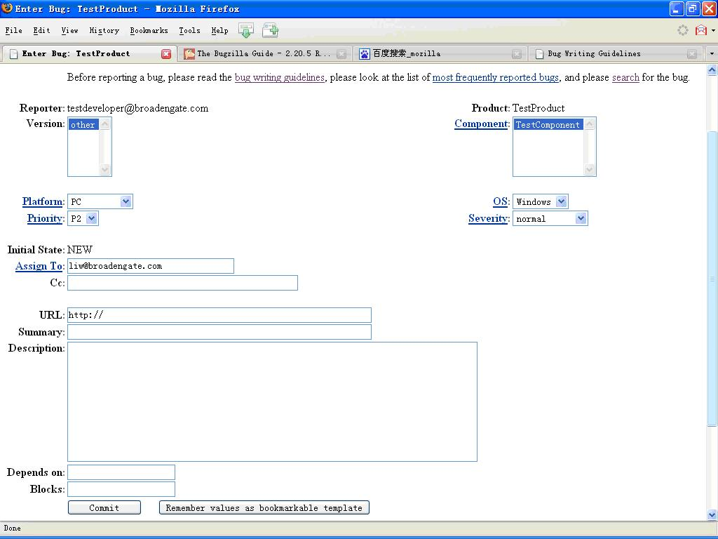
A Sample
This bug cannot be fixed until another bug has been fixed, put another bug’s ID right here
This is your account
In which sub-part of the software does the bug exists?
On which Operating
system (OS) did you find the bug?
P1-P5: From highest to lowest
To whom you assign the bug
Will also receive the bug report
Link for More information
This bug will block another bug’s fixing, put another bug’s ID right here
Simple description of the bug
Selections:
Blocker
Critical
Major
Normal
Minor
Trivial
Enhancement
The details of your problem report, including: Steps to reproduce, Actual Result, Expected Result and etc.
Notes:
Notes: In some updated versions of Bugzilla, there are some additional fields, such as attachment, keywords and so on.
If you have reproduced the bug in a recent build and no-one else appears to have reported it, then choose ‘New’ , select the product and fill out the form:

Slide 16

How to write an effective defect
Principles
Accurate
Evidence
Condense
Impact
Precise
Re-create
Neutralize
Notes:
How to write an effective defect
Principles
Condense - Say it clearly but briefly
Accurate - Is it a defect or could it be user error, misunderstanding, etc.?
Neutralize - Just the facts. No zingers. No humor. No emotion.
Precise - Explicitly, what is the problem?
Re-create - What are the essentials in triggering/re-creating this problem? (environment, steps, conditions)
Impact - What is the impact to the customer? What is the impact to test? Sell the defect.
Evidence - What documentation will prove the existence of the error?

Slide 17
How to write an effective defect
Summary
Condense - Say it clearly but briefly
Defects will often be searched by its summary
Brief but make sense
Key Words
Explain problems or what happens
Neutralize
Notes:
Summary: How would you describe the bug? (use brief words)

Slide 18
How to write an effective defect
Descriptions
Pre-condition
Test Steps
Actual Results
Expected Results
Additional Information
Notes:
Description: The details of your problem report, including:
Overview: More detailed restatement of summary.
Steps to Reproduce: Minimized, easy-to-follow steps that will trigger the bug, including any special setup steps.
Actual Results: What the application did after performing the above steps.
Expected Results: What the application should have done, were the bug not present.
Build Date & Platform: Date and platform of the build in which ou first encountered the bug.
Additional Builds and Platforms: Whether or not the bug takes place on other platforms(or browsers).
Addition Information: screenshot, attachment, test data/file, etc.

Slide 19
Defect Tracking
Severity | Definition | Example | Business Critical? | Process Stop?
S1 | Business critical process, application or interface experiencing a process stop defect with no prudent and/or feasible workaround. | Cannot book an order Cannot post a General Ledger Journal Entry at Month End (GL JE at M/E) | YES | YES
S2 | Business critical process, application or interface experiencing a non-process stop defect. | Maintain product price factors not calculating product price Cannot post a Journal through ADI (workaround is to enter manually – extremely tedious) | YES | NO
S3 | Non-business critical process, application or interface experiencing a process stop defect with no prudent and/or feasible workaround | Cannot copy an order Alerts not being posted to UAI | NO | YES
S4 | Non-business critical process, application or interface experiencing a non-process stop defect. | Bill to contact not displayed on Sales Order replication through SOM Users getting kicked off system randomly while performing query transactions | NO | NO
S5 | Minor defect that does not affect normal business operation. | Maintain price lists fields auto-populating upon opening Error messages that needlessly occur | NO | NO
S6 | Enhancement Request | Add a new column to a report Change the sort on a report | N/A | N/A

Slide 20
Defect Tracking Process

Slide 21
Defect Tracking Matrix
Status | Action | Owner | Participant
New | A defect is reported in QC | Generally QA | Everyone in Project team
Cannot Duplicate | Review and check it cannot re-produced. | QA | QA, Developers
Duplicate Bug | Review and check it is duplicate with another defect | QA | QA, Developers
Not a Bug | Review and clarify it is not a defect | QA | QA, Developers, BA
Open | Review and confirm it is a defect | QA | QA, Developers, BA
Deferred | Review and determine to defer the defect | Generally PM | Project team
Fixed | Dev fix the defect | Developers | Developers
Reopen | Did not fix this defect | QA | QA
Closed | QA verify the defect | QA | QA

Slide 22
Defect Tracking
Home Work
Install Bugzilla
Test TMS with Bugzilla
Defects description file (Deliverable)

Slide 23
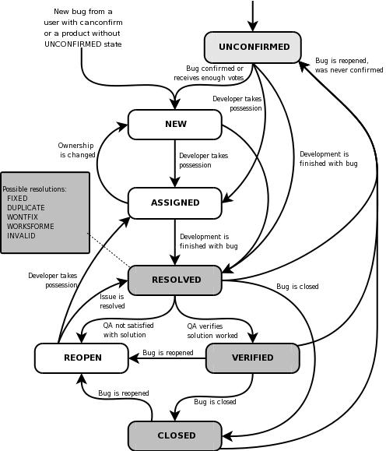
Bug Life Cycle

Slide 24
Bug Life Cycle
QA
Confirm Bugs Raised By DEV
Search for bugs: Status = Unconfirmed;
Verify whether the bug exists or not, if yes, change the status to ‘New’, and then commit.
Verify Bugs
Search for bugs: Status = Resolved, Verify whether the bug has been fixed or not, if yes, change the status to ‘Verified’; otherwise, ‘Reopened’;
After the Release of the Product, change the status from ‘Verified’ to ‘Closed’.
DEV
Bugs Belong To You
Change the status to ‘Assigned’ and take possession of the bugs
Change the status to ‘Resolved’ after finishing the bug .
Bugs NOT Belong To You
Assign back to QA or Reassign to the correct DEV

Slide 25
Bugzilla Demo
http://landfill.bugzilla.org/
https://bugzilla.mozilla.org/
http://www.bugzilla.org/
Notes:
http://landfill.bugzilla.org/

Slide 26
Demo

Slide 27
Thanks

